Slide 1
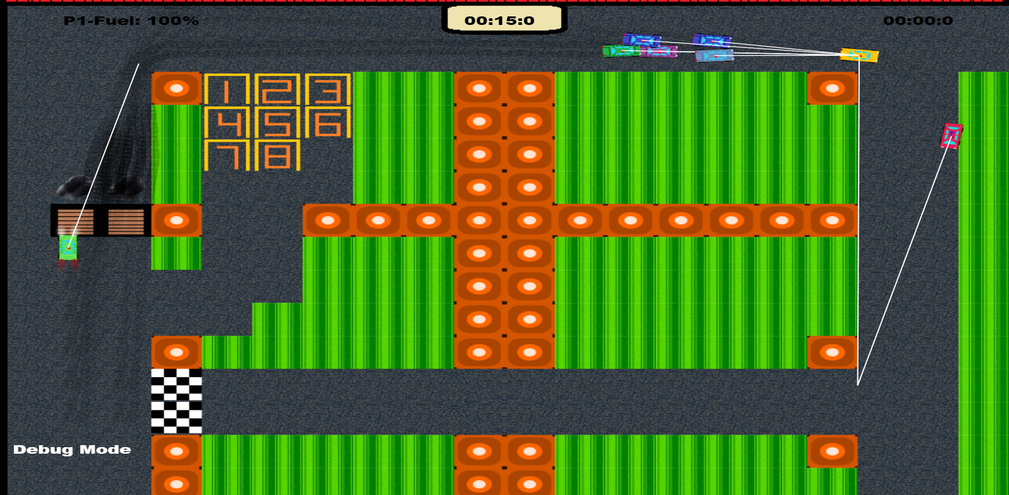
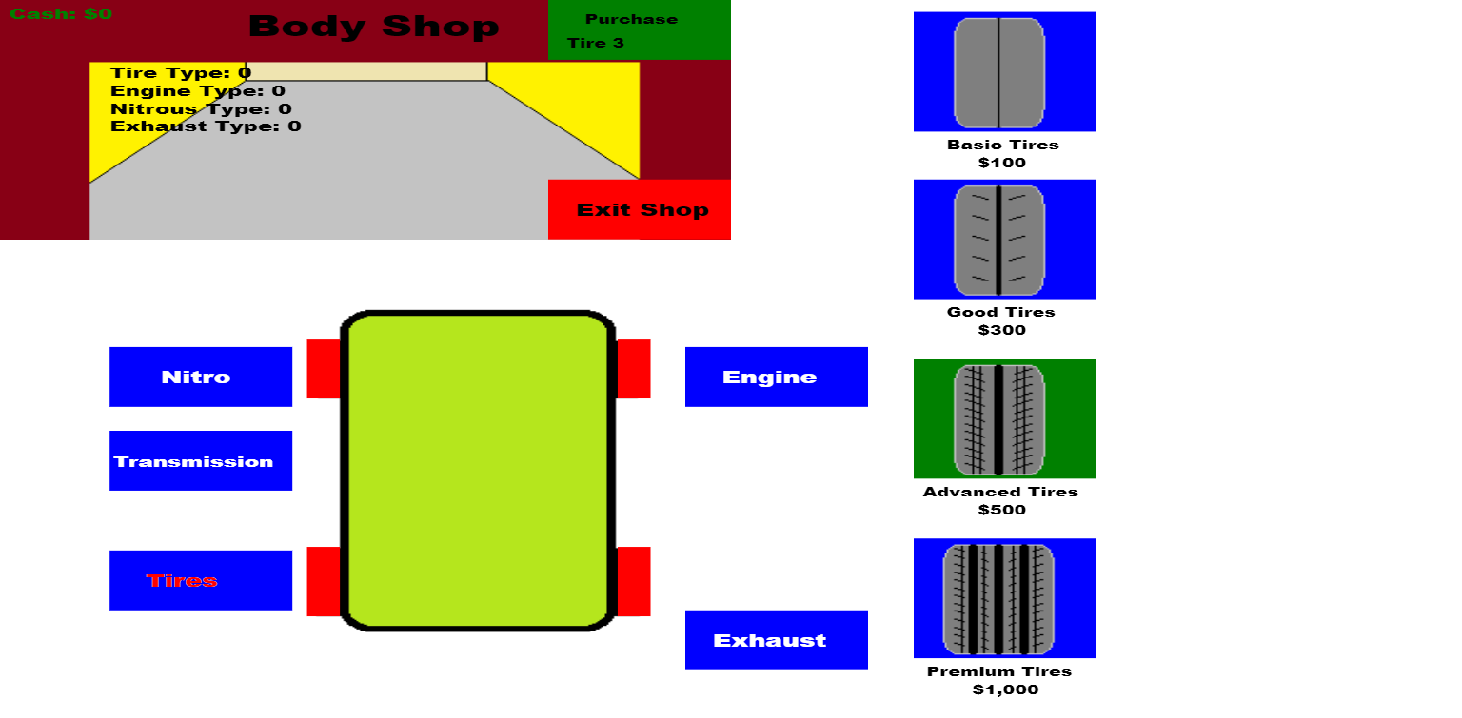
Little Racers
Pitch Date: June 22 , 2019 Week 1: 6/30/2019
Release Date: September 15, 2019 11 weeks to go!
Team Lead: Vince McKeown
8 contributors

Slide 2
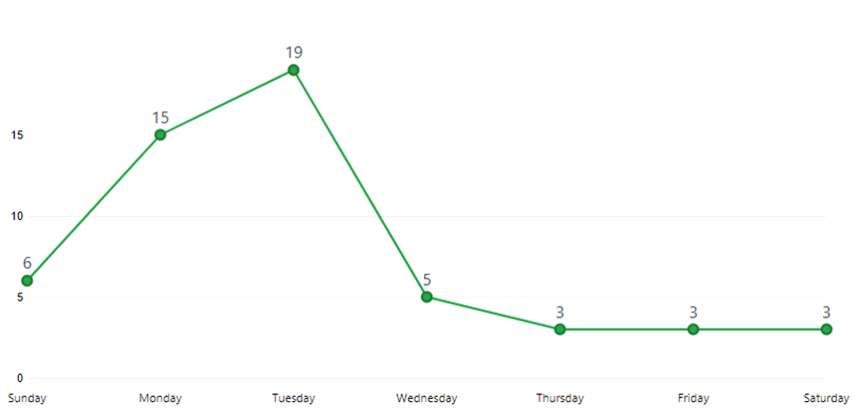
Updates to Code
54 Commits
Mike LeSauvage
First Commit!
Fixed bug preventing race from completing
Improved Collision and driving code
Created utility file for common-use function
Vince McKeown
Fixed multiple bugs with the win positions
Added Debug Function allowing to skip levels
Added winner parking spaces
Added Camera Pan
Added several functions and refactored code to the Body Shop

Slide 3
Updates to Code
54 Commits
Anthony Free
Added player car fuel management & display for both players
Added setFuel function for future capability
Christer McFunkyPants Kaitila
Added tire tracks which fade
Terrence McDonnell
Rescaled Canvas to entire screen
H Trayford
Track Tiles are drawn to off-screen canvas when new level is loaded
Randy Tan Shaoxian
Fixed capitalization errors
Added CSS properties for better display

Slide 4
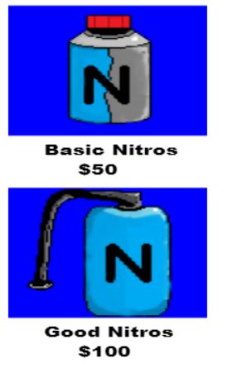
Updates to Art
Christer McFunkyPants Kaitila
Vince McKeown

Slide 5
Updates to Sound
Vince McKeown
Crash into Cones

Slide 6
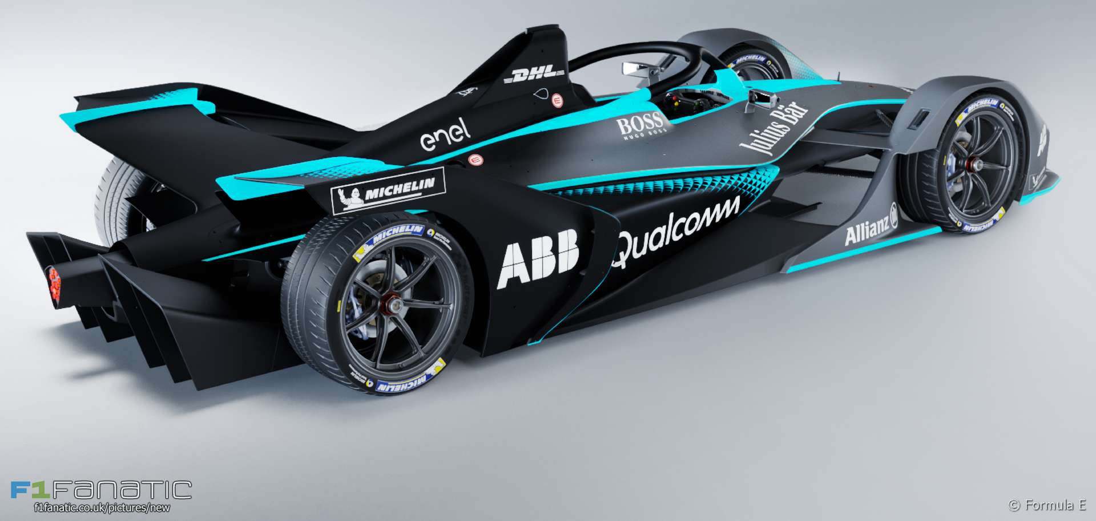
Demo
Cutover to Game

Slide 7
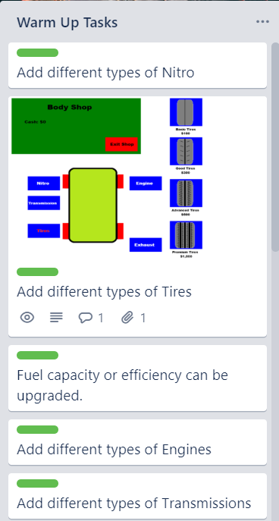
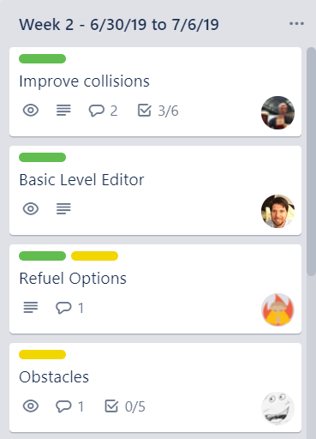
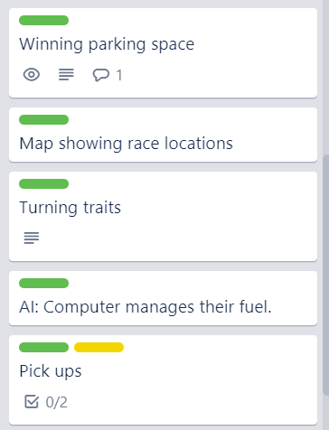
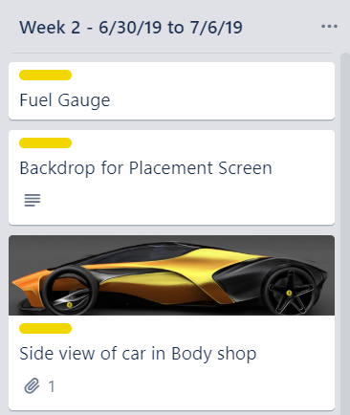
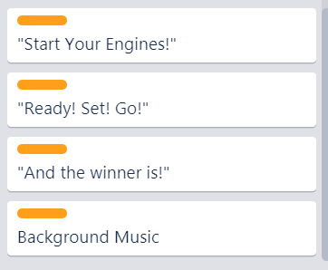
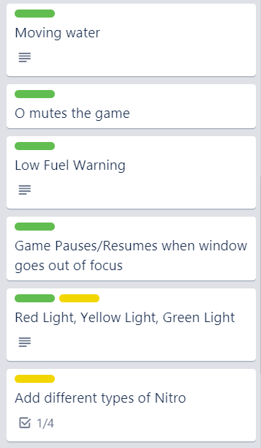
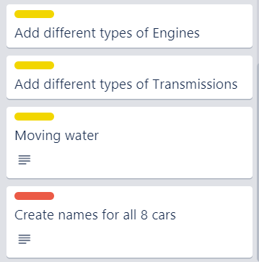
Week 2 Schedule
Committed
Code
Artwork
Sound

